Slide 1


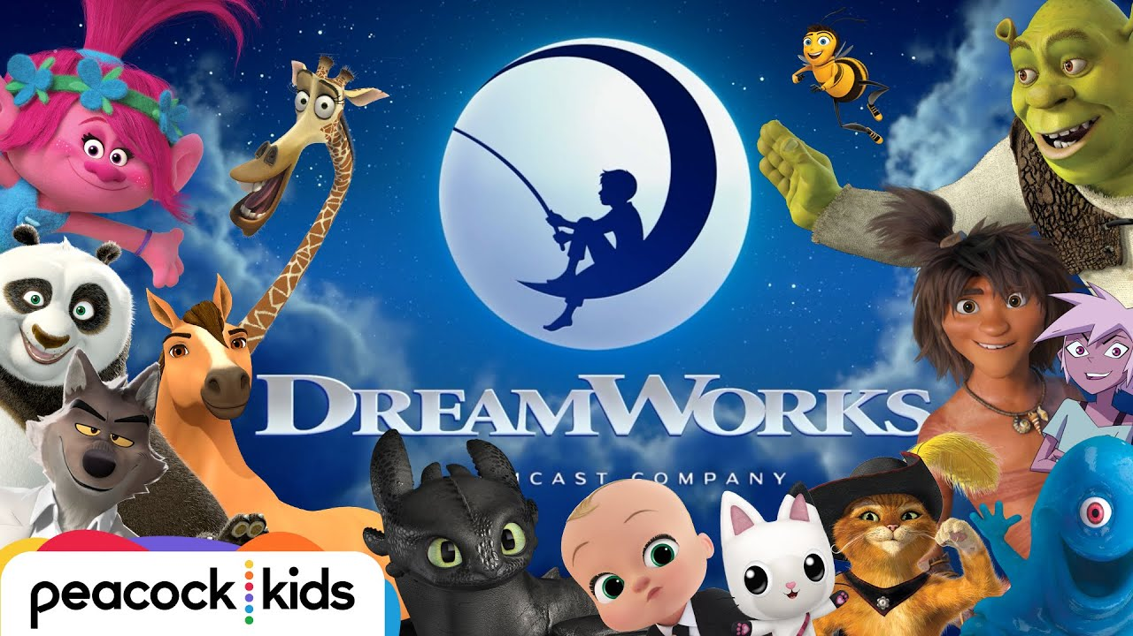
.
Dreamworks

Slide 2
BCG
Question mark
Star Stage
Cash Cow Stage
Dog Stage
The BCG Matrix categorizes a company's products into four quadrants: Stars, Question Marks, Cash Cows, and Dogs. Each quadrant represents a different strategic position
BCG is known for its strategic insights, and its consultants often work closely with top executives to address complex business challenges and opportunities.

Slide 3
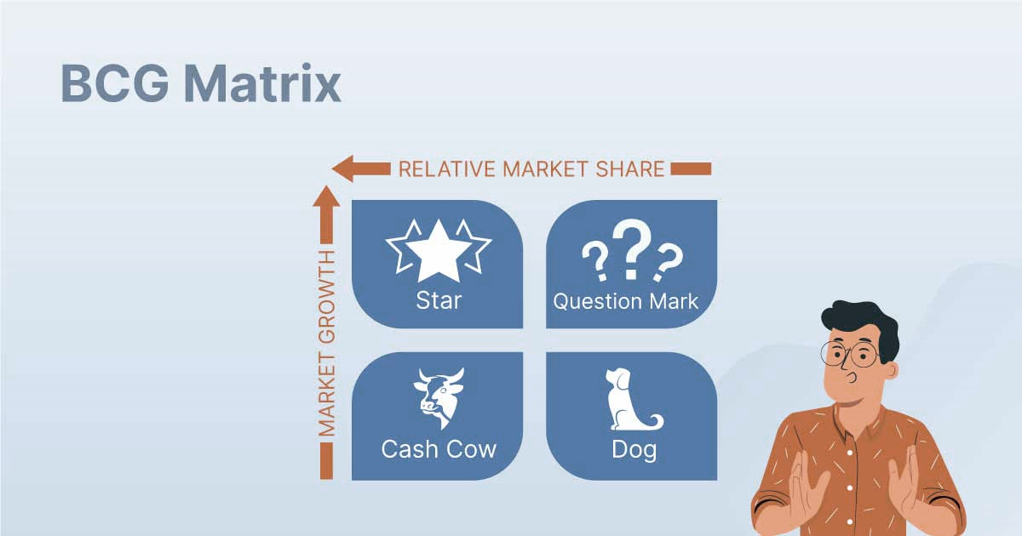
BCG
Question mark
Star Stage
Cash Cow Stage
Dog Stage

Slide 4
BCG
Question mark
Star Stage
Cash Cow Stage
Dog Stage
represents products or business units that are in a stage of uncertainty.
Newer or experimental projects that have the potential for success but may not yet have a dominant market share.
DreamWorks' newer ventures, especially those exploring emerging markets or technologies, could fall into this category.
Such as Virtual Reality (VR) Content Production, expansion into Mobile Gaming.

Slide 5
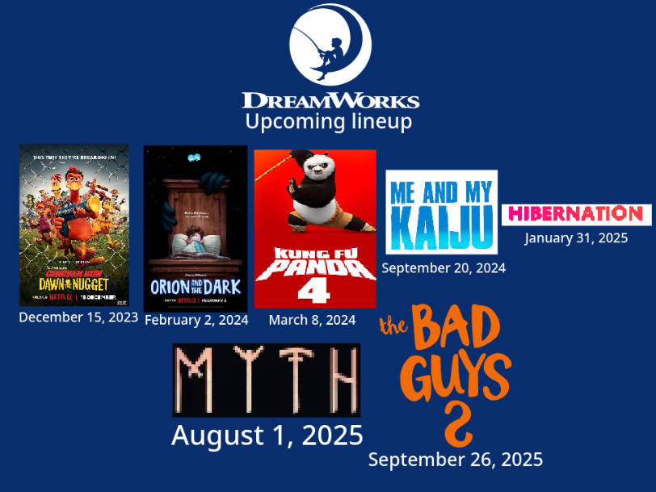
BCG
Question mark
Star Stage
Cash Cow Stage
Dog Stage

Slide 6
BCG
Question mark
Star Stage
Cash Cow Stage
Dog Stage
represent products or business units that are performing well in terms of both market share and market growth
DreamWorks Animation's successful film franchises like "Shrek" and "How to Train Your Dragon" could be considered stars.

Slide 7
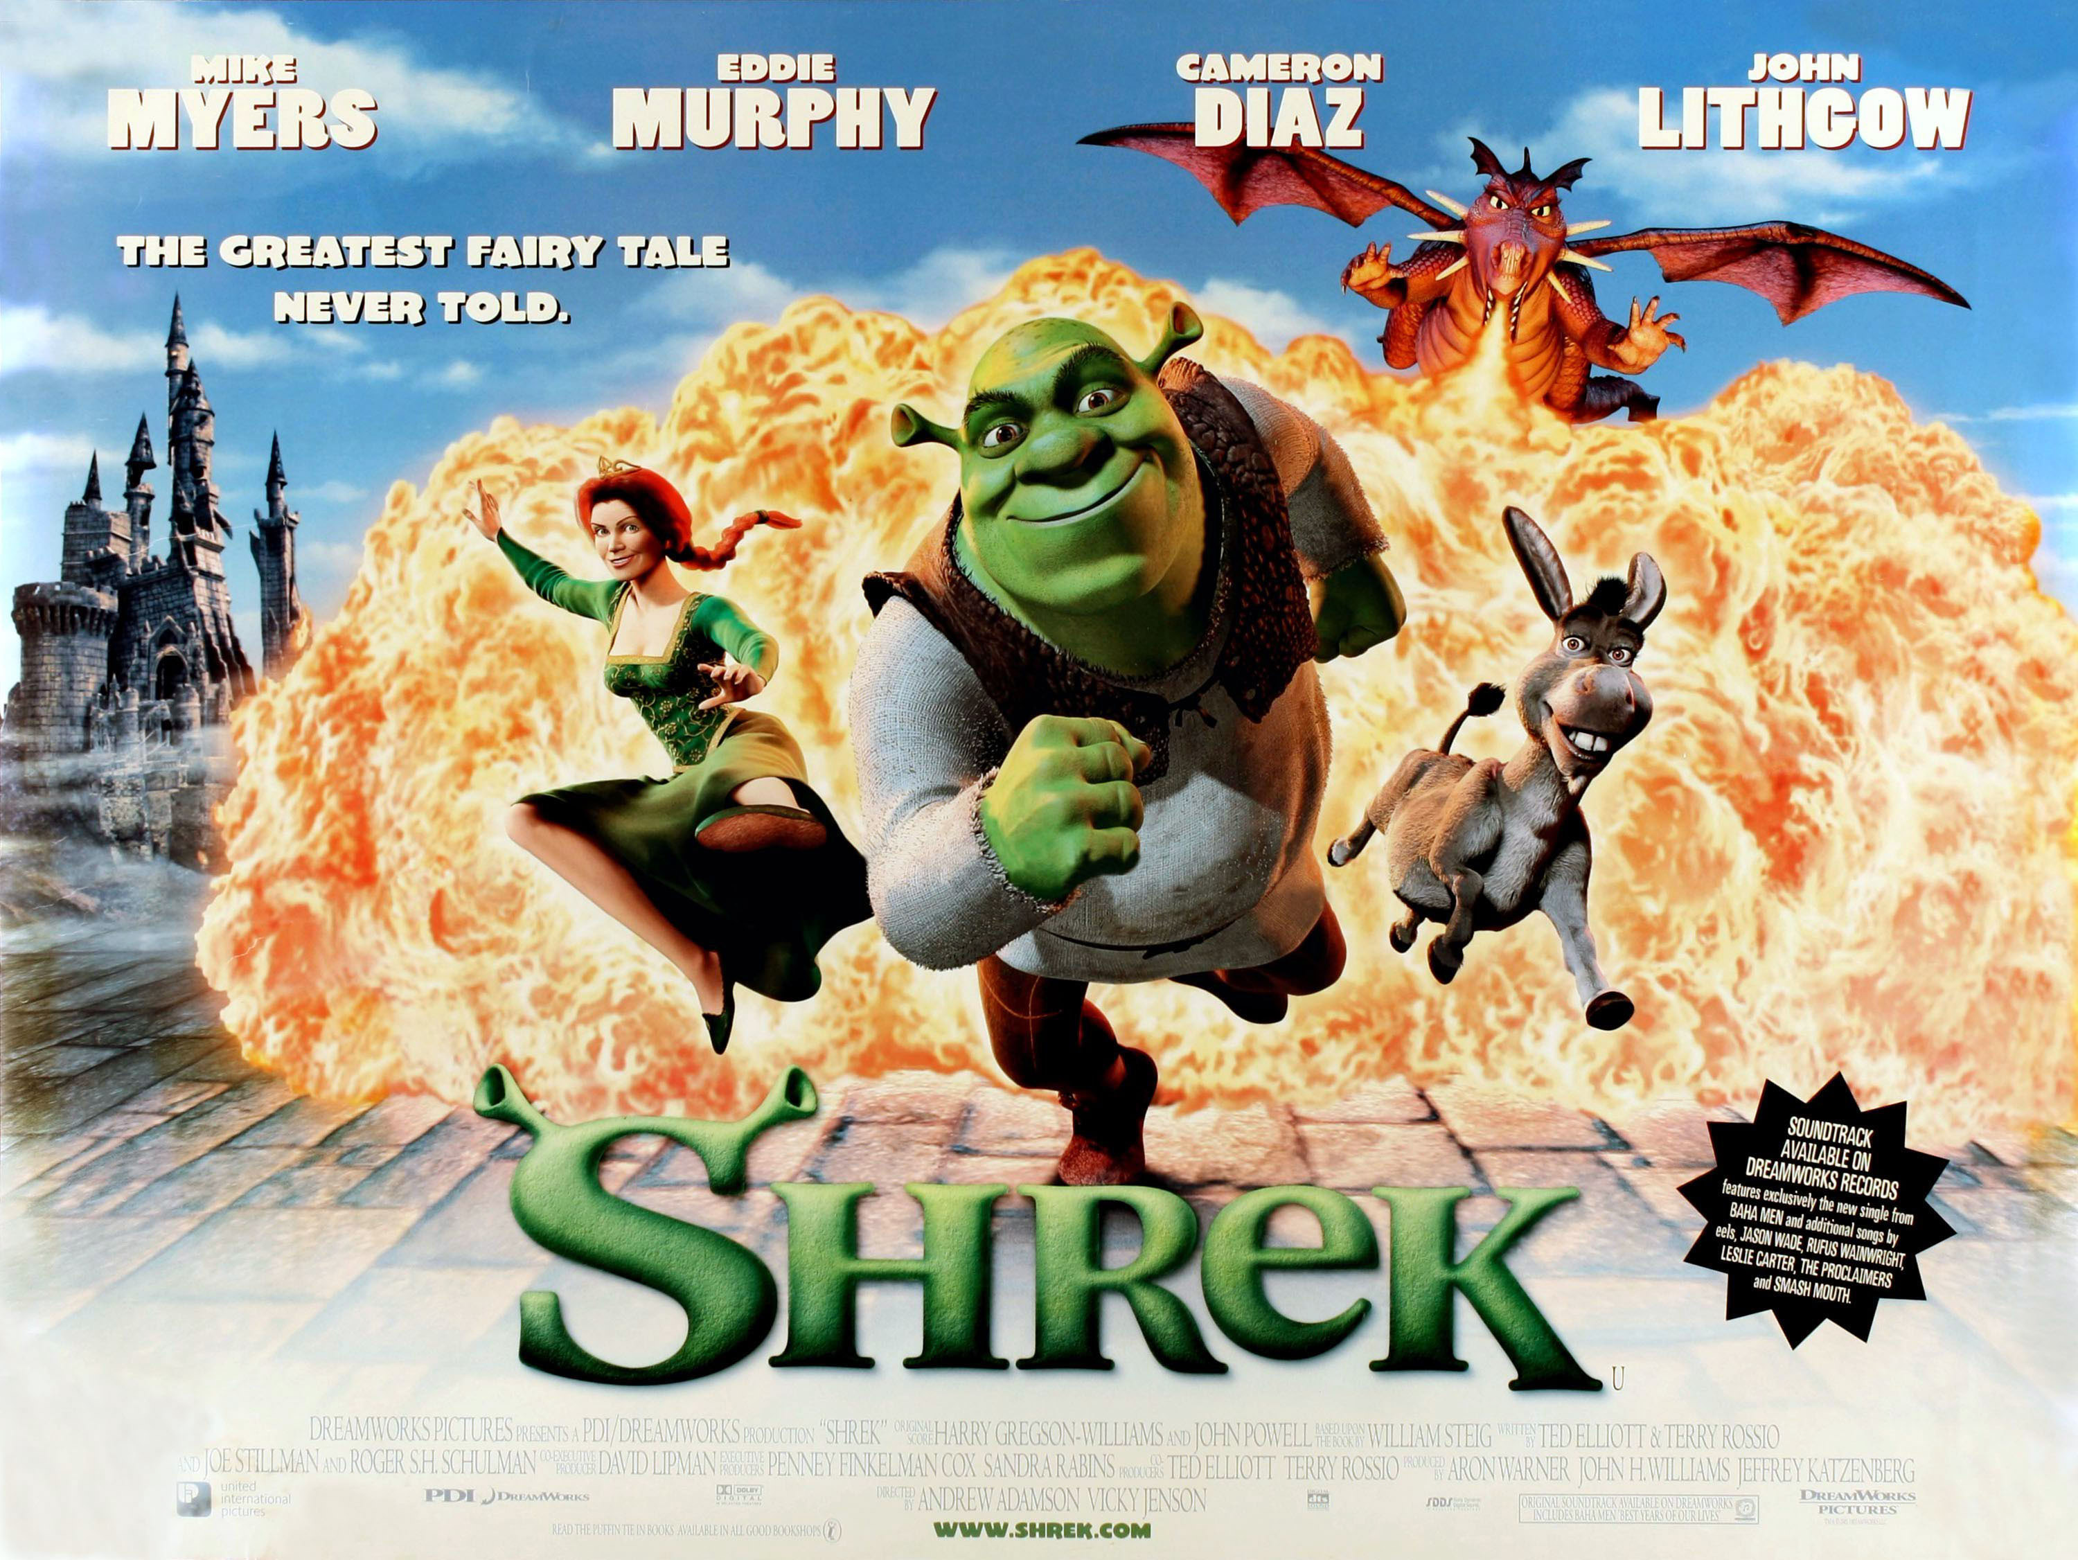
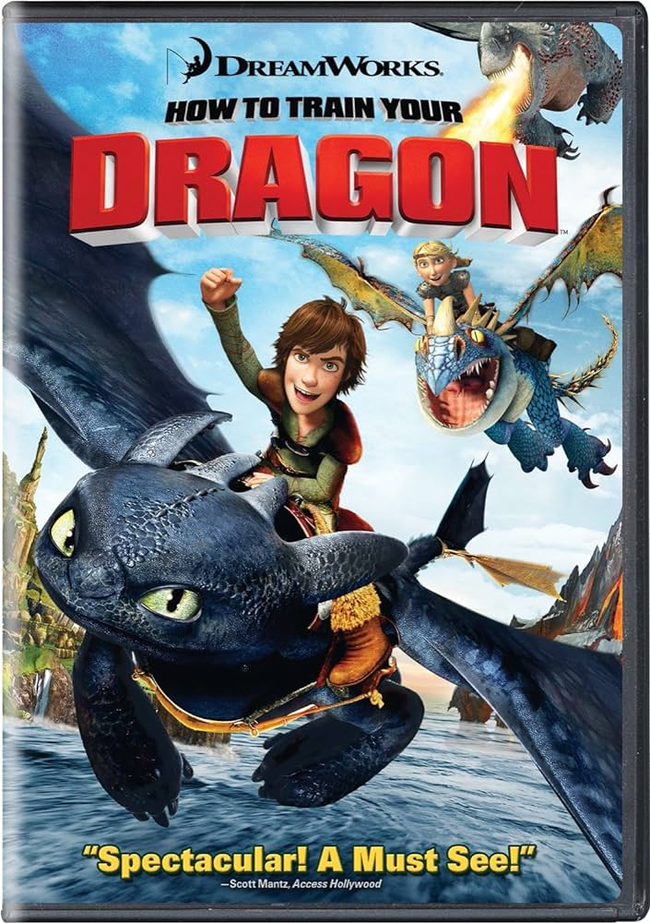
BCG
Question mark
Star Stage
Cash Cow Stage
Dog Stage

Slide 8
BCG
Question mark
Star Stage
Cash Cow Stage
Dog Stage
represent products or business units that are mature and have a dominant position in the market.
Established and successful movies that may not be actively growing but continue to generate revenue fall into this category. How??
Digital Streaming Services
Television Syndication
Licensing of Iconic Characters:
ETC….

Slide 9
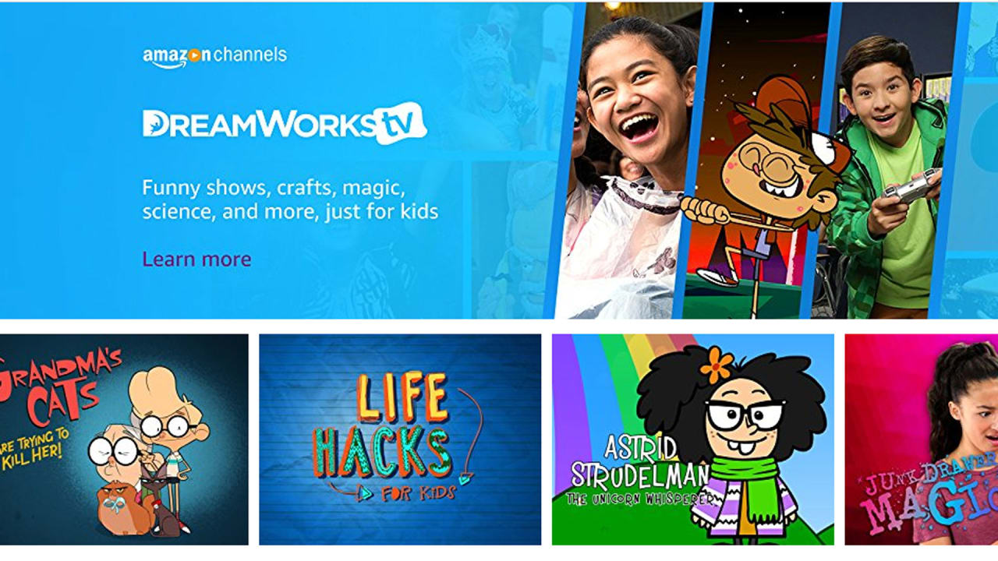
BCG
Question mark
Star Stage
Cash Cow Stage
Dog Stage

Slide 10
BCG
Question mark
Star Stage
Cash Cow Stage
Dog Stage
represent products or business units that have a limited market share in slow-growing or declining markets.
Any underperforming films or projects that haven't gained much traction could be considered dogs.
Such as Sinbad, Rise of the Guardians …..

Slide 11
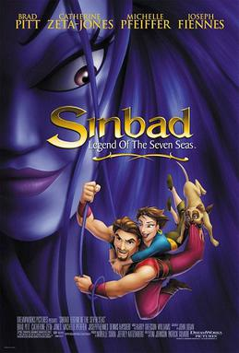
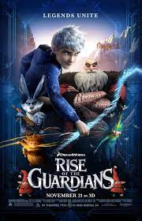
BCG
Question mark
Star Stage
Cash Cow Stage
Dog Stage

Slide 12
SWOT
Strengths
Weaknesses
Opportunities
Threats
is a strategic planning tool used by businesses and organizations to identify and evaluate their internal strengths and weaknesses, as well as external opportunities and threats.
SWOT analysis is a tool that enhances strategic thinking, decision-making, and overall organizational effectiveness.

Slide 13
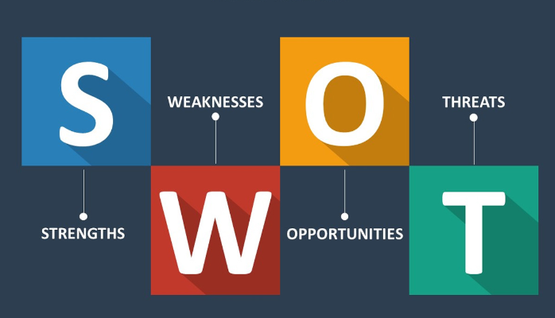
SWOT
Strengths
Weaknesses
Opportunities
Threats

Slide 14
SWOT
Strengths
Weaknesses
Opportunities
Threats
refer to the internal attributes, capabilities, and resources that give an organization a competitive advantage and contribute to its success.
Strong brand recognition and intellectual properties.
Access to a different types of entertainment content.
Synergies with AT&T's broader media and telecommunications assets.

Slide 15
SWOT
Strengths
Weaknesses
Opportunities
Threats
refer to the internal attributes, characteristics, or limitations that may hinder an organization's performance and competitive position.
Dependence on hit-driven industries, which can be unpredictable.
Potential challenges in adapting to rapidly changing consumer preferences.
Integration challenges with AT&T's broader corporate structure.

Slide 16
SWOT
Strengths
Weaknesses
Opportunities
Threats
refer to external factors and situations that an organization can leverage to its advantage for growth, development, or strategic advantage.
Expanding into new markets or collaborating with international studios.
Leveraging emerging technologies in animation and entertainment.
Creating original content for streaming platforms.

Slide 17
SWOT
Strengths
Weaknesses
Opportunities
Threats
refer to external factors and challenges that could potentially harm the organization's performance, competitiveness, or ability to achieve its objectives.
Increasing competition in the animation industry such as Disney and warner bros.
Changes in consumer preferences or a decline in the popularity of animated films.
Economic downturns affecting the entertainment industry such as politics etc...

Slide 18

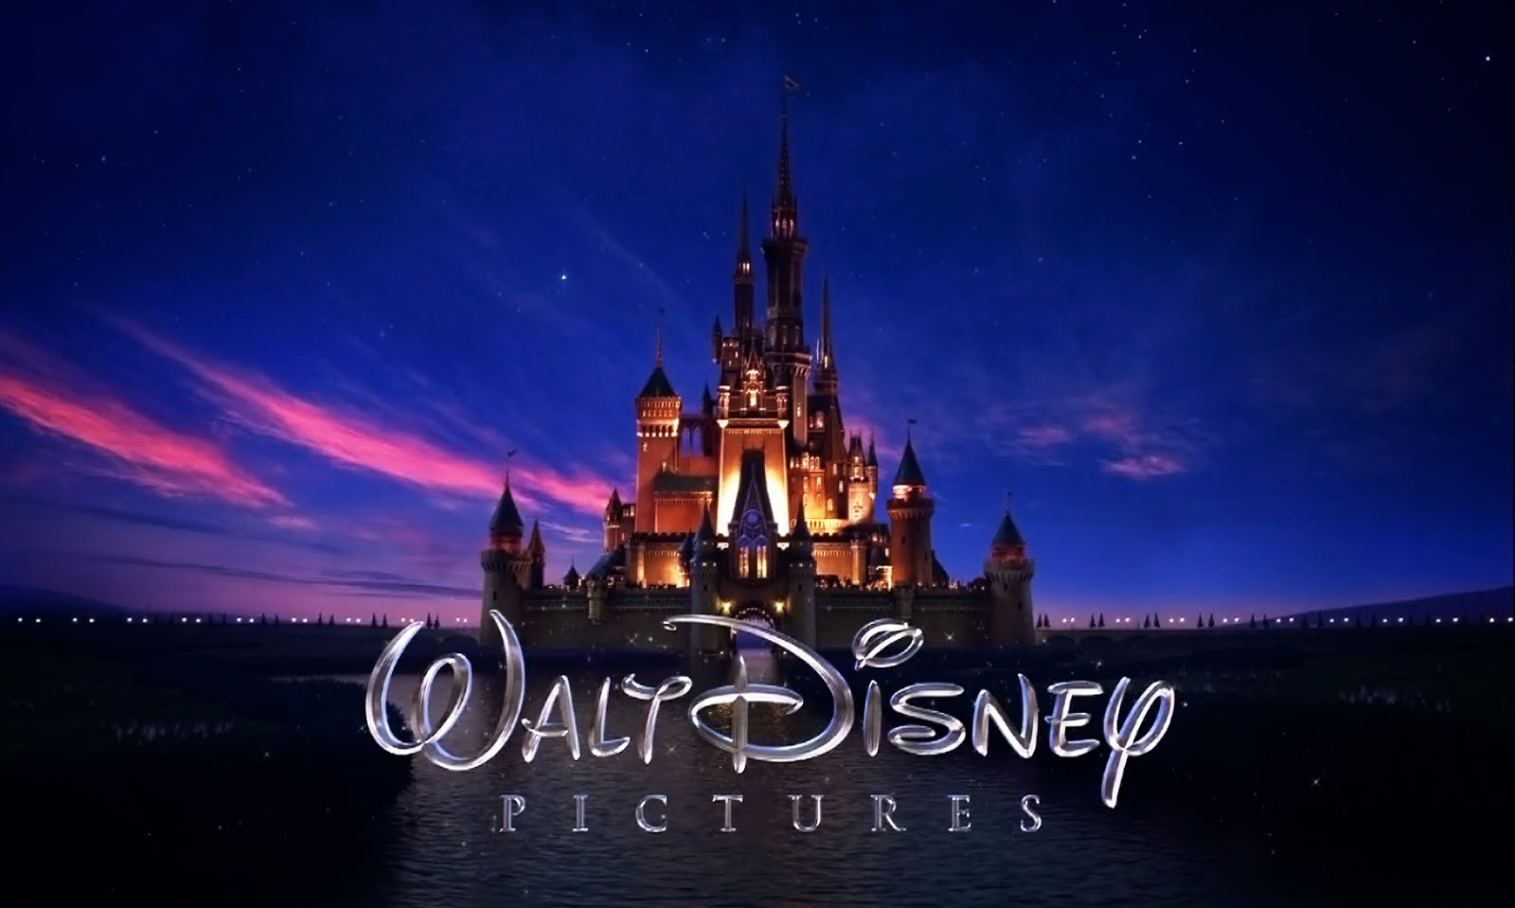
SWOT
Strengths
Weaknesses
Opportunities
Threats

Slide 19
SWOT
Strengths
Weaknesses
Opportunities
Threats
S
W
Leveraging strong brand recognition to create original content for streaming platforms.
Expanding successful franchises into new markets through collaborations with international studios.
Collaborating with international studios to bring in new creative talent and expand the studio's reach.
Exploring emerging technologies to create a competitive edge and mitigate weaknesses in the face of industry advancements.
O
Mitigating the risk of increasing competition by focusing on maintaining strong brand recognition and quality content.
Developing strategies to navigate economic downturns, such as cost-effective production and diversified revenue streams.
Developing strategies to navigate increasing competition and maintaining market share.
Implementing cost-effective measures and financial strategies to withstand economic downturns.
T

